Slide 1

Introduction to algorithms Sorting algorithms for lists
Lecture 6
Thursday, 4 November 2021

Slide 2
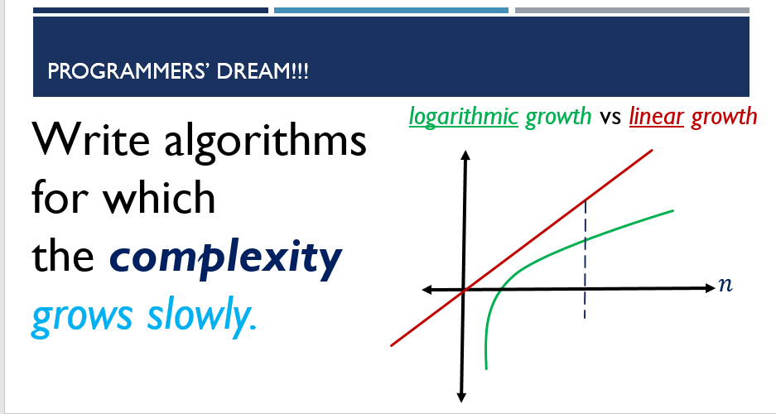






Recap of last lecture
worst-case
complexity
best-case
complexity
requires
sorted list?
Search algorithm
Linear Search
$$O(n)$$
$$O(1)$$
$$no$$
Binary Search
$$O(\log{n})$$
$$O(1)$$
$$yes$$
7 | 9 | 0 | 1 | 3 | 5 | 2
sort
Sorted
0 | 1 | 2 | 3 | 5 | 7 | 9

Slide 3
sorting algorithms (comparison sort)
O(n²)
O(n log n)
O(n)
Sorting Scheme | Time Complexity (worst case)
Bubble Sort | O(n²)
Quick Sort | O(n²)
Insertion Sort | O(n²)
Selection Sort | O(n²)
Merge Sort | O(n log n)

Slide 4
sorting algorithms (comparison sort)
O(n²)
O(n log n)
O(n)
Sorting Scheme | Time Complexity (worst case)
Bubble Sort | O(n²)
Quick Sort | O(n²)
Insertion Sort | O(n²)
Selection Sort | O(n²)
Merge Sort | O(n log n)
Divide & Conquer

Slide 5
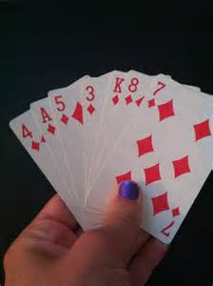
Insertion sort: idea
Insertion Sort: takes an unsorted list and returns a sorted list (ascending)
Hold all the cards in your left hand (unsorted!!)
Take the first card from your left hand, and put it in your right hand.
Take the next card from your left hand, and insert it into the cards in your right hand making sure that at any time you keep all the cards in your right hand sorted.
Repeat step 3 until you have no cards in your left hand.

Slide 6
Insertion sort: picture
Left hand
7 | 9 | 0 | 1 | 3 | 5 | 2
Right hand

Slide 7
Insertion sort: picture
Left hand
7 | 9 | 0 | 1 | 3 | 5 | 2
Right hand

Slide 8
Insertion sort: picture
Left hand
 | 9 | 0 | 1 | 3 | 5 | 2
Right hand
7

Slide 9
Insertion sort: picture
Left hand
 | 9 | 0 | 1 | 3 | 5 | 2
Right hand
7

Slide 10
Insertion sort: picture
Left hand
 |  | 0 | 1 | 3 | 5 | 2
Right hand
7 | 9

Slide 11
Insertion sort: picture
Left hand
 |  | 0 | 1 | 3 | 5 | 2
Right hand
7 | 9

Slide 12
Insertion sort: picture
Left hand
 |  |  | 1 | 3 | 5 | 2
Right hand
0 | 7 | 9

Slide 13
Insertion sort: picture
Left hand
 |  |  | 1 | 3 | 5 | 2
Right hand
0 | 7 | 9

Slide 14
Insertion sort: picture
Left hand
 |  |  |  | 3 | 5 | 2
Right hand
0 | 1 | 7 | 9

Slide 15
Insertion sort: picture
Left hand
 |  |  |  | 3 | 5 | 2
Right hand
0 | 1 | 7 | 9

Slide 16
Insertion sort: picture
Left hand
 |  |  |  |  | 5 | 2
Right hand
0 | 1 | 3 | 7 | 9

Slide 17
Insertion sort: picture
Left hand
 |  |  |  |  | 5 | 2
Right hand
0 | 1 | 3 | 7 | 9

Slide 18
Insertion sort: picture
Left hand
 |  |  |  |  |  | 2
Right hand
0 | 1 | 3 | 5 | 7 | 9

Slide 19
Insertion sort: picture
Left hand
 |  |  |  |  |  | 2
Right hand
0 | 1 | 3 | 5 | 7 | 9

Slide 20
Insertion sort: picture
Left hand
Right hand
0 | 1 | 2 | 3 | 5 | 7 | 9
Sorted!!

Slide 21

Insertion sort: think about time complexity (worst-case)
$$0+1+2+…+\left(n−1\right)=\frac{\left(n−1\right)\left(n−2\right)}{2}=O(n^{2})$$
For a list of length n:
Count the number of
comparisons required
for each insertion and
add them all up.

Slide 22
Insertion sort: summary
Insertion Sort has two components:
Make Comparisons
Then
Insert element in the right position

Slide 23
Merge-sort: idea
DIVIDE
SORT
MERGE

Slide 24
Merge-sort: idea
4
1
6
7
3
8
2
5
DIVIDE
4
1
6
7
3
8
2
5
SORT
1
4
6
7
2
3
5
8
MERGE
1
2
3
4
5
6
7
8

Slide 25
Merge-sort: idea
DIVIDE
SORT
recursively!
MERGE

Slide 26
Merging two sorted lists
0 | 2 | 4 | 9
1 | 5 | 6 | 8

Slide 27
Merging two sorted lists
0 | 2 | 4 | 9
1 | 5 | 6 | 8

Slide 28
Merging two sorted lists
 | 2 | 4 | 9
1 | 5 | 6 | 8
0

Slide 29
Merging two sorted lists
 | 2 | 4 | 9
1 | 5 | 6 | 8
0

Slide 30
Merging two sorted lists
 | 2 | 4 | 9
 | 5 | 6 | 8
0 | 1

Slide 31
Merging two sorted lists
 |  | 4 | 9
 | 5 | 6 | 8
0 | 1 | 2

Slide 32
Merging two sorted lists
 |  |  | 9
 | 5 | 6 | 8
0 | 1 | 2 | 4

Slide 33
Merging two sorted lists
 |  |  | 9
 |  | 6 | 8
0 | 1 | 2 | 4 | 5

Slide 34
Merging two sorted lists
 |  |  | 9
 |  |  | 8
0 | 1 | 2 | 4 | 5 | 6

Slide 35
Merging two sorted lists
 |  |  | 9
0 | 1 | 2 | 4 | 5 | 6 | 8

Slide 36
Merging two sorted lists
0 | 1 | 2 | 4 | 5 | 6 | 8 | 9

Slide 37
Merge-sort: recursive algorithm
DIVIDE
Divide until you get to single-element lists
single-element lists are already sorted!!
SORT
recursively!
Merge lists from the bottom to top to make bigger sorted lists
Backtracking
MERGE

Slide 38
example
[5,8,4,2,9,0]
[5,8,4] [2,9,0]
[5] [8,4]
[2] [9,0]

Slide 39
example
[5,8,4,2,9,0]
[5,8,4] [2,9,0]
Base case
[5] [8,4]
[2] [9,0]
[8] [4]
[9] [0]

Slide 40
example
[5,8,4,2,9,0]
[5,8,4] [2,9,0]
Base case
[5] [8,4]
[2] [9,0]
merge
Base case
[8] [4]
[9] [0]

Slide 41
example
[5,8,4,2,9,0]
[5,8,4] [2,9,0]
Base case
[5] [4,8]
[2] [9,0]
merge
Base case
[8] [4]
[9] [0]

Slide 42
example
[5,8,4,2,9,0]
[5,8,4] [2,9,0]
Base case
[5] [4,8]
[2] [0,9]
merge
Base case
[8] [4]
[9] [0]

Slide 43
example
[5,8,4,2,9,0]
[5,8,4] [0,2,9]
Base case
[5] [4,8]
[2] [0,9]
merge
Base case
[8] [4]
[9] [0]

Slide 44
example
[5,8,4,2,9,0]
[4,5,8] [0,2,9]
Base case
[5] [4,8]
[2] [0,9]
merge
Base case
[8] [4]
[9] [0]

Slide 45
example
Sorted list
[0,2,4,5,8,9]
[4,5,8] [2,0,9]
Base case
[5] [4,8]
[2] [0,9]
merge
Base case
[8] [4]
[9] [0]

Slide 46
Quicksort: idea
k
pivot
Partitioning: make two sublists
Less than k
k
Greater than k
left partition
right partition

Slide 47
Quicksort: idea
k
pivot
Partitioning: make two sublists
f
k
pivot
Less than f
f
bigger than f

Slide 48
Quicksort: idea
k
pivot
Partitioning: make two sublists
f
k
t
pivot
Less than f
f
bigger than f
Less than t
t
bigger than t
.
.
.
.
.
.

Slide 49
Quicksort: idea
k
pivot
Partitioning: make two sublists
f
k
t
.
.
.
.
.
.
Single elements
a
<
d
<
f
<
j
<
k
<
m
<
p
<
o
<
t

Slide 50
Quicksort: idea
k
pivot
Partitioning: make two sublists
f
k
t
.
.
.
.
.
.
MERGE:
a
d
f
j
k
m
p
o
t

Slide 51
Quicksort: idea
partition
SORT
recursively!
MERGE

Slide 52
example
[5,8,4,2,9,0]

Slide 53
example
[5,8,4,2,9,0]
[0,2,4][5][9,8]

Slide 54
example
[5,8,4,2,9,0]
[0,2,4][5][9,8]
[][0][4,2]

Slide 55
example
[5,8,4,2,9,0]
[0,2,4][5][9,8]
[][0][4,2]
[8][9][]

Slide 56
example
[5,8,4,2,9,0]
[0,2,4][5][9,8]
[][0]
[4,2]
[8][9][]
Base case

Slide 57
example
[5,8,4,2,9,0]
[0,2,4][5][9,8]
[][0]
[4,2]
[8][9][]
Base case
[2][4][]

Slide 58
example
[5,8,4,2,9,0]
[0,2,4][5][9,8]
[][0]
[4,2]
[8][9][]
Base case
[2][4][]
Base case
MERGE:
[][0]
[2][4][]
[5]
[8][9][]
[0,2,4,5,8,9]

Slide 59
Practice & think
Sort these two lists using
the quicksort scheme.
Compare the number
of steps involved in each case.
What do you conclude?
[6,8,1,2,3,0]
[0,1,2,3,8,6]

